Slide 1
Predicting Consumer Personal Loan Eligibility Using Machine Learning
By: Rasesh, Brandon, Ravi

Slide 2
Project Description
The goal of our project is to develop a machine learning (ML) model that predicts a consumer's eligibility for a personal loan based on their credit score and other financial indicators. In the finance industry, accurately assessing loan eligibility is crucial for both financial institutions and consumers. Traditional credit scoring models often fail to capture the full picture of a borrower’s financial health, leading to suboptimal lending decisions.
Our project aims to address this issue by creating a more nuanced prediction model that considers multiple factors beyond just the credit score, thereby improving the accuracy of loan eligibility predictions.

Slide 3
Dataset(s) / Model(s) /Algorithm(s) to Be Used
Dataset: We plan to use publicly available datasets from sources such as Kaggle or the UC Irvine Machine Learning Repository, which include credit scores, loan application outcomes, income, debt-to-income ratios, and other relevant financial indicators.
Algorithms:
Decision Tree: For initial model creation and feature importance analysis.
Random Forest: For improving accuracy and handling overfitting.
Logistic Regression: As a baseline model to compare against more complex models.
Support Vector Classifiers: Used for finding the optimal boundary (hyperplane) between classes in a high-dimensional space, making it effective for both linear and non-linear classification problems. It works well with complex datasets and is often used when high precision is needed.

Slide 4
Data Exploration/Cleaning
1.We imported the necessary libraries to handle and manipulate the dataset
2.We read the dataset into a Pandas Dataframe
3.Cleaned the data by checking for missing values and duplicates
4.Feature Scaling: Scaled the numerical features to ensure uniformity in model training

Slide 5
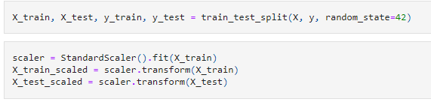
Data Training and Scaling
Importance of Data Training
Learning: Models learn patterns from training data to make accurate predictions.
Accuracy: Good training data improves model performance.
Generalization: Proper training prevents overfitting or underfitting.
Importance of Data Scaling
Equal Feature Impact: Ensures that all features contribute equally to model predictions.
Faster Learning: Scaling helps models converge faster.
Improved Accuracy: Prevents larger features from dominating smaller ones, leading to better predictions.

Slide 6
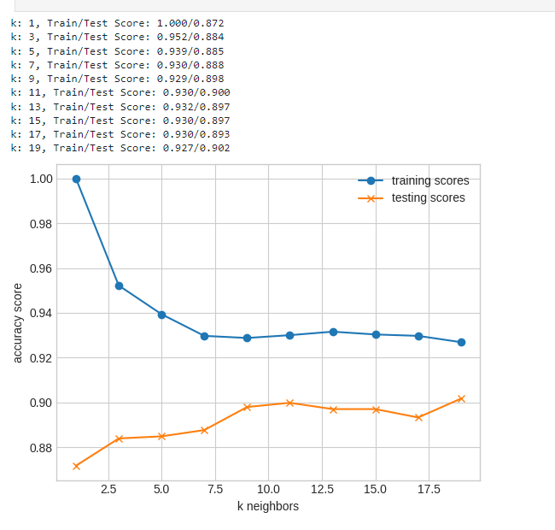
ML Model - KNeighborsClassifier
The KNeighborsClassifier is a machine learning model used for classification tasks based on the proximity of data points. Its primary purpose is to classify a data point by considering the labels of its nearest neighbors.
Summary of KNeighborsClassifier's Purpose:
Classifies data based on nearest neighbors using distance metrics.
Instance-based learning where no explicit model is built.
Non-parametric and can handle non-linear decision boundaries.
Uses majority voting to determine class labels.
Simple and versatile, but requires feature scaling.
Sensitive to outliers and computationally expensive with large datasets.

Slide 7
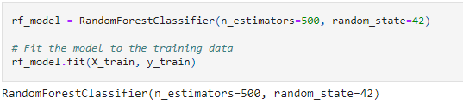
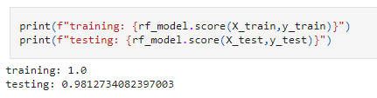
ML Model - RandomForestClassifier
The RandomForestClassifier is a machine learning model used for classification tasks, and its primary purpose is to improve predictive accuracy and control overfitting by combining the results of multiple decision trees into one robust model.
Summary of RandomForestClassifier Purpose:
Combines multiple decision trees to make more accurate predictions.
Reduces overfitting and improves generalization.
Handles large datasets with high dimensionality.
Provides feature importance insights.
Reduces model variance through ensemble learning.

Slide 8
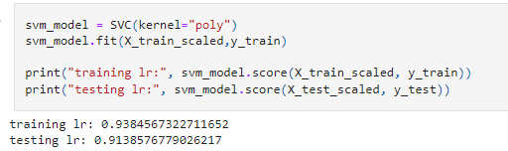
ML Model - Support Vector Classifier
The purpose of SVC (Support Vector Classifier) is to perform classification tasks by finding the optimal boundary (hyperplane) between different classes of data points. SVC is particularly effective when the data is complex or not linearly separable, and it is used to create robust models with strong generalization capabilities.
Summary of SVC's Purpose:
Classifies data into distinct categories.
Maximizes margin for better generalization.
Handles non-linear data using kernels.
Resists outliers by relying on key support vectors.

Slide 9
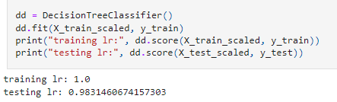
ML Model - Decision Tree Classifier
The DecisionTreeClassifier is a machine learning model used for classification tasks, and its primary purpose is to create a model that predicts the class label of a target variable by learning simple decision rules inferred from the data features.
Summary of Decision Tree Classifier Purpose:
Classifies data based on decision rules derived from features.
Provides easy-to-interpret decision-making paths.
Captures both linear and non-linear relationships.
Performs feature selection to identify the most important features.
Handles both categorical and continuous data.
No need for feature scaling or normalization.

Slide 10
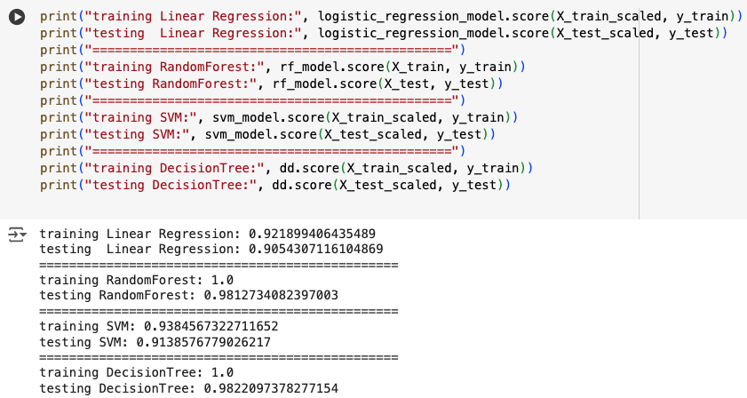
Trained / Tested ML Results

Slide 11
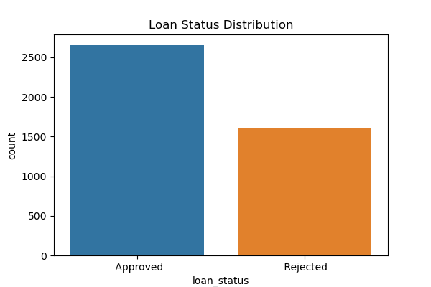
Loan Status Distribution
Loan Status Distribution refers to the analysis and visualization of the various outcomes of loans within a dataset, such as loans that are approved, rejected, paid off, defaulted, or in-progress. Understanding the distribution of loan statuses is crucial for several reasons, particularly in financial analysis and risk management.
Summary of Loan Status Distribution's Purpose:
Risk assessment and early detection of potential issues in loan portfolios.
Creditworthiness evaluation of borrowers to adjust lending practices.
Tracking loan performance over time.
Informing model building for predictive analytics.
Driving business strategies for loan products and terms.
Ensuring regulatory compliance with financial reporting standards.

Slide 12
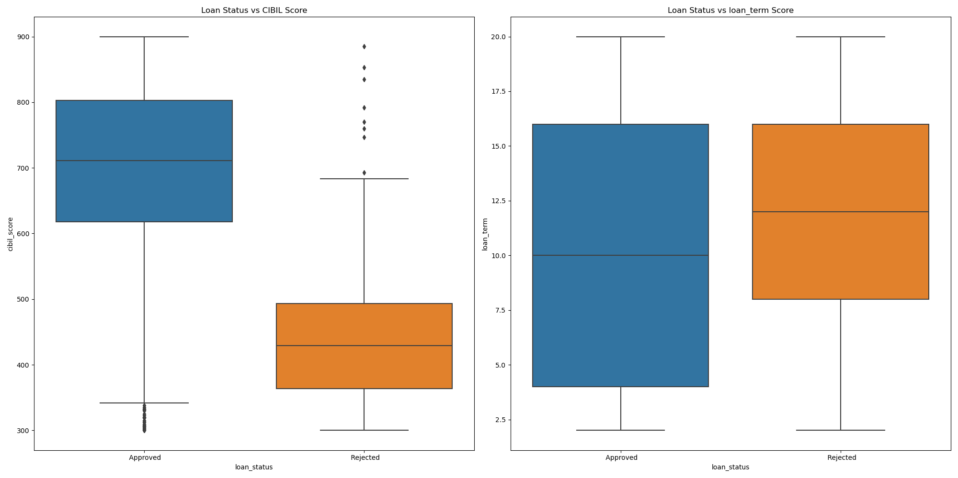
Loan Status vs. Features

Slide 13
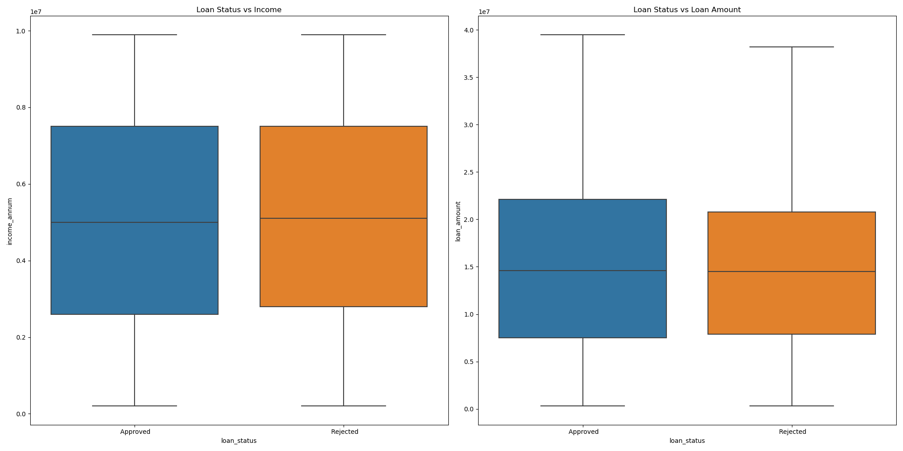
Loan Status vs. Features Con’t

Slide 14
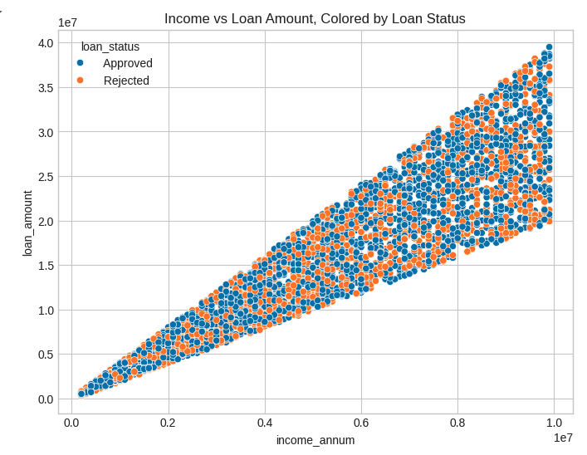
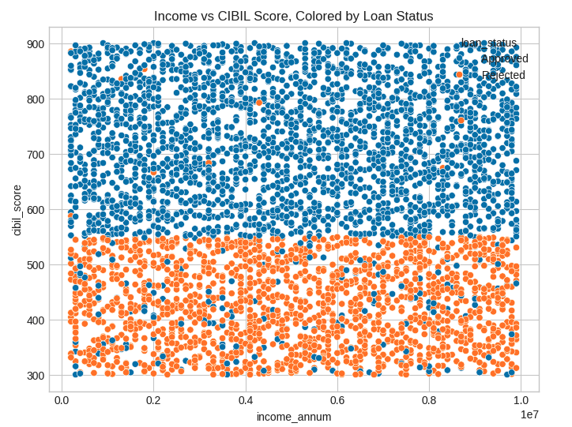
Scatter Plot Visuals

Slide 15
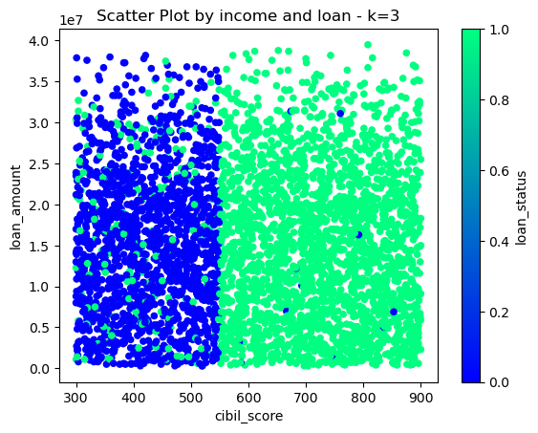
Scatter Plot Visuals loan Amount/Credit Score and approvals

Slide 16
Final Conclusion
Project Overview and Model Performance
In our project, we aimed to analyze credit scores and predict consumer personal loan eligibility using a variety of machine learning models. We employed Logistic Regression, Random Forest Classifier, Support Vector Machine (SVM), and Decision Tree models to achieve this goal. Each model was evaluated on both training and testing datasets to ensure its performance and generalizability.
Model Performance Summary:
Logistic Regression:
Training Accuracy: 92.19%
Testing Accuracy: 90.54%
Random Forest Classifier:
Training Accuracy: 100%
Testing Accuracy: 98.13%
Support Vector Machine (SVM):
Training Accuracy: 93.85%
Testing Accuracy: 91.39%
Decision Tree:
Training Accuracy: 100%
Testing Accuracy: 98.22%

Slide 17
Best Performing Model
Among the models evaluated, the Random Forest Classifier and the Decision Tree achieved the highest testing accuracy, both exceeding 98%. These models demonstrated excellent performance in predicting loan eligibility, with Random Forest showing a testing accuracy of 98.13% and Decision Tree achieving 98.22%. Both models provided an almost perfect fit to the training data, indicating their robustness in handling the dataset.
The slight difference in performance between Random Forest and Decision Tree may be attributed to Random Forest ensemble learning technique, which aggregates the results of multiple decision trees to enhance overall accuracy and reduce overfitting.

Slide 18
Feature Impact Analysis
Our analysis revealed that several features significantly impacted loan status predictions:
CIBIL Score: This feature was the most influential in determining loan approval. Higher CIBIL scores were strongly correlated with loan approval, highlighting its critical role in assessing creditworthiness.
Loan Amount: The analysis showed that higher loan amounts were more likely to be approved compared to lower amounts. This could be due to the fact that individuals applying for larger loans were generally better qualified and had more substantial financial backing.
Loan Term: The loan term also played a crucial role. Loans with shorter terms were more likely to be approved compared to those with longer terms. Rejected loans tended to have longer terms, which might indicate higher risk associated with extended repayment periods.

Slide 19
Conclusion
In summary, our project successfully applied machine learning techniques to predict loan eligibility, with Random Forest Classifier and Decision Tree models emerging as the most effective. The most impactful features were CIBIL Score, Loan Amount, and Loan Term, each playing a significant role in the prediction process. Our findings suggest that higher CIBIL scores and loan amounts are associated with higher approval rates, while longer loan terms are linked with higher rejection rates.
Moving forward, we recommend further exploration of additional features and possibly incorporating more advanced models to refine our predictions and enhance accuracy. Future development could also involve creating an interactive tool for real-time loan eligibility assessment based on the model's predictions.

